Slide 1

Let’s Create an Extension That Steals Everything
Asaf Shochet Avida

Slide 2
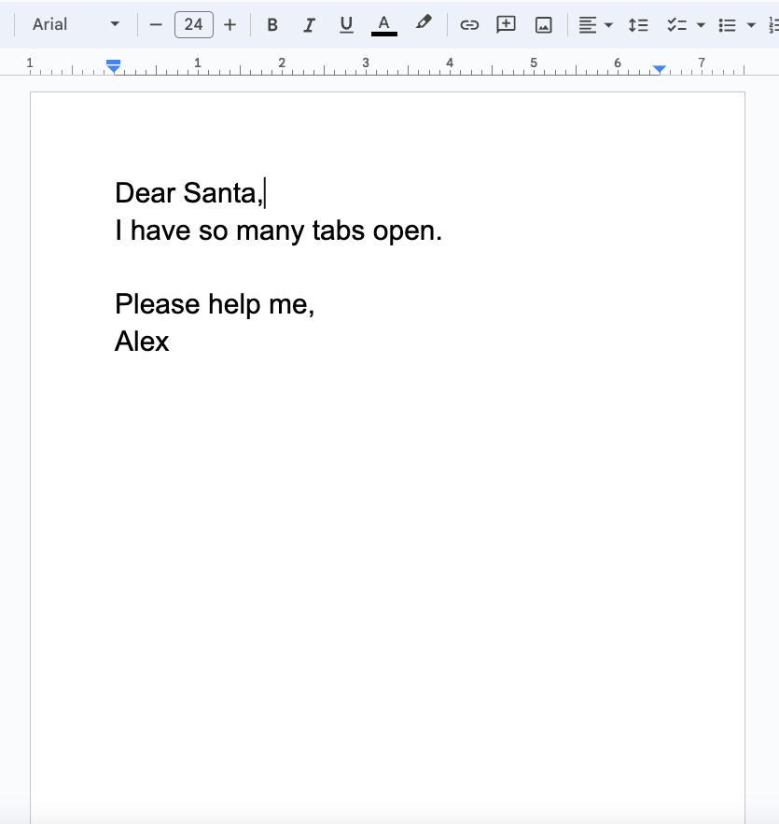

Story Time
Notes:
Let’s start with a story
Imaging you are a web developer, or someone else working on a day to day basis with their computer
And the browser is getting heavier, slower. Hard to use. So you hear about an extension called the Great Suspender which shuts down unused tabs
And it works! So you tell your friends, and they are installing it – all 100,000+ of them.
And one day you find that
Let’s start with a story
Imaging you are a web developer, or someone else working on a day to day basis with their computer
And the browser is getting heavier, slower. Hard to use. So you hear about an extension called the Great Suspender which shuts down unused tabs
And it works! So you tell your friends, and they are installing it – all 100,000+ of them.
And one day you find that It was malware, and you are infected.
Not by Phishing or by plugging a USB drive to your laptop while you’re at the pull.
By an extensions that did something good, and you installed it.
So how does it happen?
Today… We are going to do the same thing.
First, let me introduce myself.

Slide 3
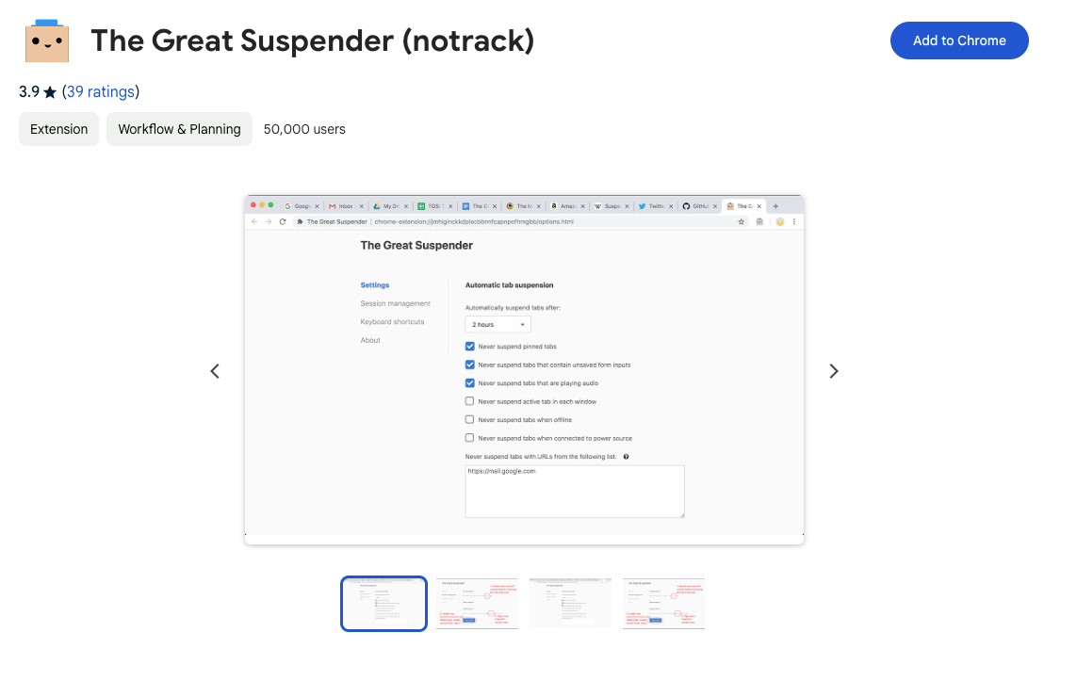
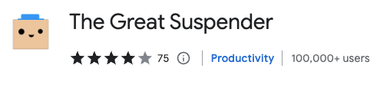
Introducing the great suspender

Slide 4
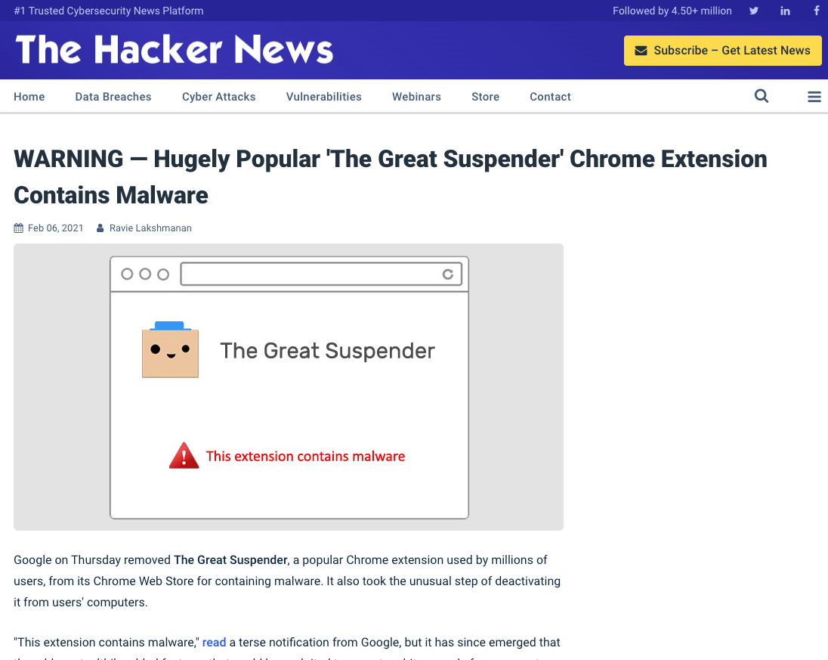
Great suspender turns out to be spyware

Slide 5




Speaker introduction
Asaf Shochet Avida
Frontend Tech Lead @Evinced
asaf-shochet frogrammer.net
Notes:
I’m the father of Eitan, Sahar and Aviv, Married to Neta
I’m the frontend tech lead at Evinced, an amazing startup the help large organizations make their apps and web apps accessible using technologies like AI, Computer vision to detect accessibility issues, accessibility web crawlers, and… web extensions, where I got familiar with this subject.
While working on our own chrome extensions, based on my interest in security, I started exploring the different capabilities chrome extensions have but from an attacker’s perspective, and that got me thinking.

Slide 6
Agenda
What is a browser extension
Build a do-good extension
Make it evil
What can we do?
Touching summary
👿

Slide 7



What is a web extension?
“Extensions are software programs, built on web technologies that enable users to customize their browsing experience.”
https://developer.chrome.com/docs/extensions/
Notes:
Take a moment and think what extensions do you have installed on your machine, now think technically what do they need to have access to in order to do that thing they do.
Adblock – need to know which elements are loaded to the page and identify them.
Last pass – needs access to your passwords + form fields.
VPN – needs access to all of your network requests
Accessibilty tools – need access to the document to check color contrast for instance
Grammarly – needs access to the content of your documents, emails, etc.
Pretty sensitive stuff.

Slide 8
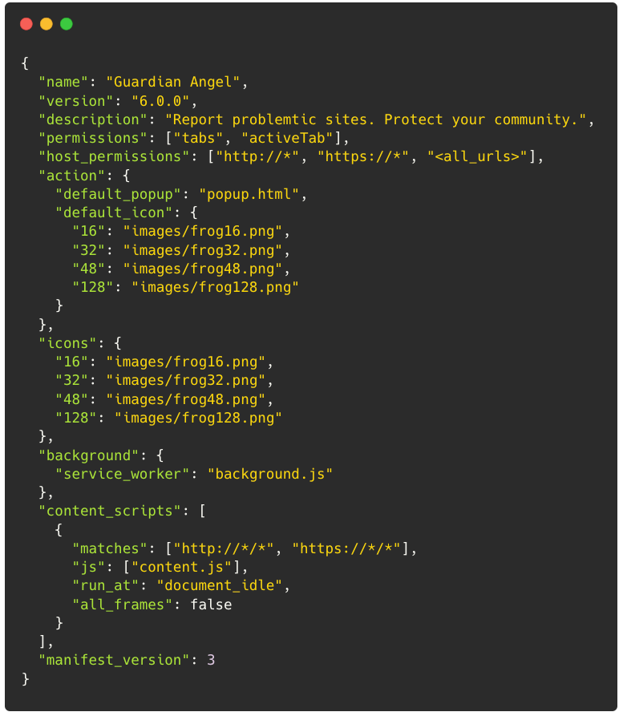
Extension Parts
Manifest
Metadata
Behavior
Permissions

Slide 9


Scripts
Content Script
Runs on the page itself
Background Script
Service worker, no UI
Responds to browser events

Slide 10
Available Permissions (Partial)
Tabs
Downloads
Geo Location
Identity
Web Navigation - Browsing history
System Storage - Connected storage devices
https://developer.chrome.com/docs/extensions/reference/permissions-list

Slide 11
Let’s create an extension!

Slide 12

Explaining what we are going to build
Say hi to…
Report harmful content. Protect your freedom.

Slide 13
And now
Let’s start coding! (Moving to code editor after this slide)
Code Code Code Code Code Code Code Code Code Code Code Code Code Code Code Code Code Code Code Code Code Code Code Code Code Code Code Code Code Code Code Code Code Code Code Code Code Code Code Code Code Code Code Code Code Code Code Code Code Code Code Code Code Code Code Code Code Code Code Code Code Code Code Code Code Code Code Code Code Code Code Code Code Code Code Code Code Code Code Code Code Code Code Code Code Code Code Code Code Code Code Code Code Code Code Code Code Code Code Code Code Code Code Code Code Code Code Code Code Code Code Code Code Code Code Code Code Code Code Code Code Code Code Code Code Code Code Code Code Code Code Code Code Code Code Code Code Code Code Code Code Code Code Code Code Code Code Code Code Code Code Code Code Code Code Code Code Code Code Code Code Code Code Code Code Code Code Code Code Code Code Code Code Code Code Code Code Code Code Code Code Code Code Code Code Code Code Code Code Code Code Code Code Code Code Code Code Code Code Code Code Code Code Code Code Code Code Code Code Code Code Code Code Code Code Code Code Code Code Code Code Code Code Code Code Code Code Code Code Code Code Code Code Code Code Code Code Code Code Code Code Code Code Code Code Code Code Code Code Code Code Code.
Code.
Notes:
Add a button
Show that the code is injected to the page, and send events
Track urls
=> go to a bank site
Listen to keyboard
Hijack data from local storage
Screenshots

Slide 14
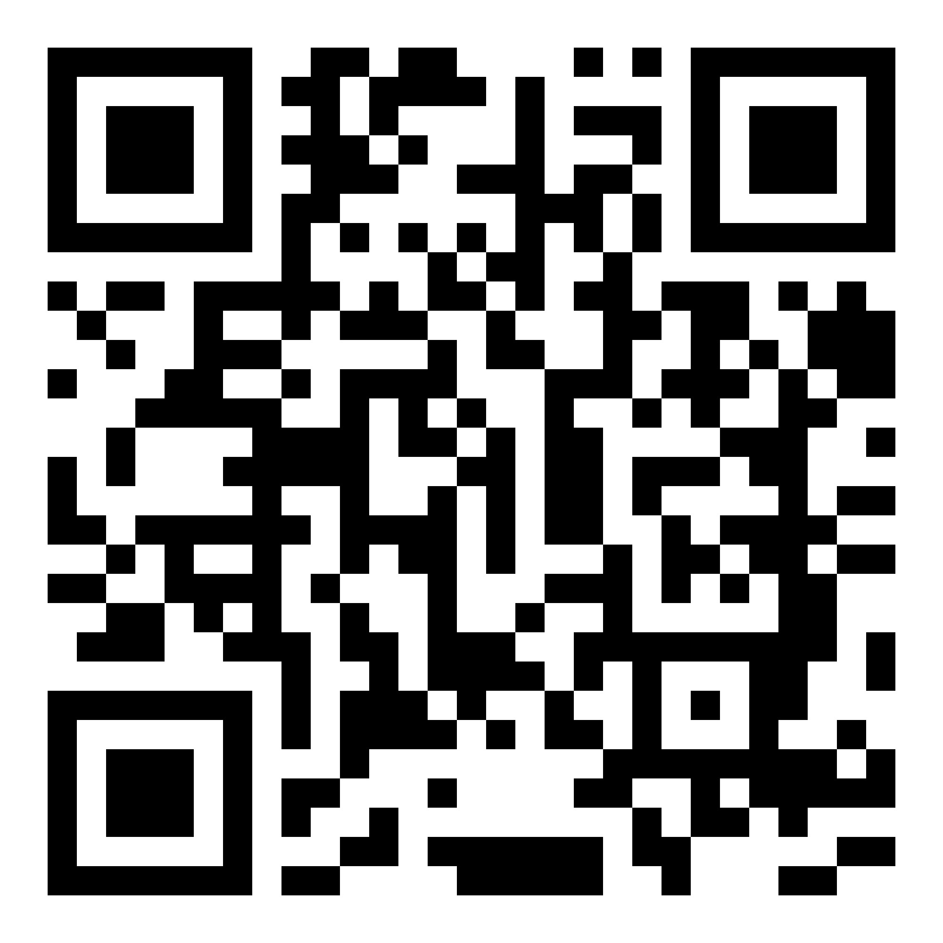
Github Link
https://github.com/AsafShochet/extension-that-steals-everything

Slide 15
What can we do?

Slide 16


Mv3 To the Rescue?
Performance
Move Background to Service Worker
Security
No external code execution
Improve permissions model

Slide 17
Showing the manifest.json file of our application

Slide 18
Showing our application’s manifest version is the new one (mv3)

Slide 19



No, Really. How can we defend?
No way to block extensions from running on your website
Allow/Block Extensions
Restrict Permissions
Prefer known vendors
Disable when not needed
Review permissions

Slide 20
Touching Summary
Extensions are powerful
Extensions can be evil
Now what?

Slide 21
Thanks for listening!
Asaf Shochet Avida
asaf-shochet frogrammer.net

